Slide 1

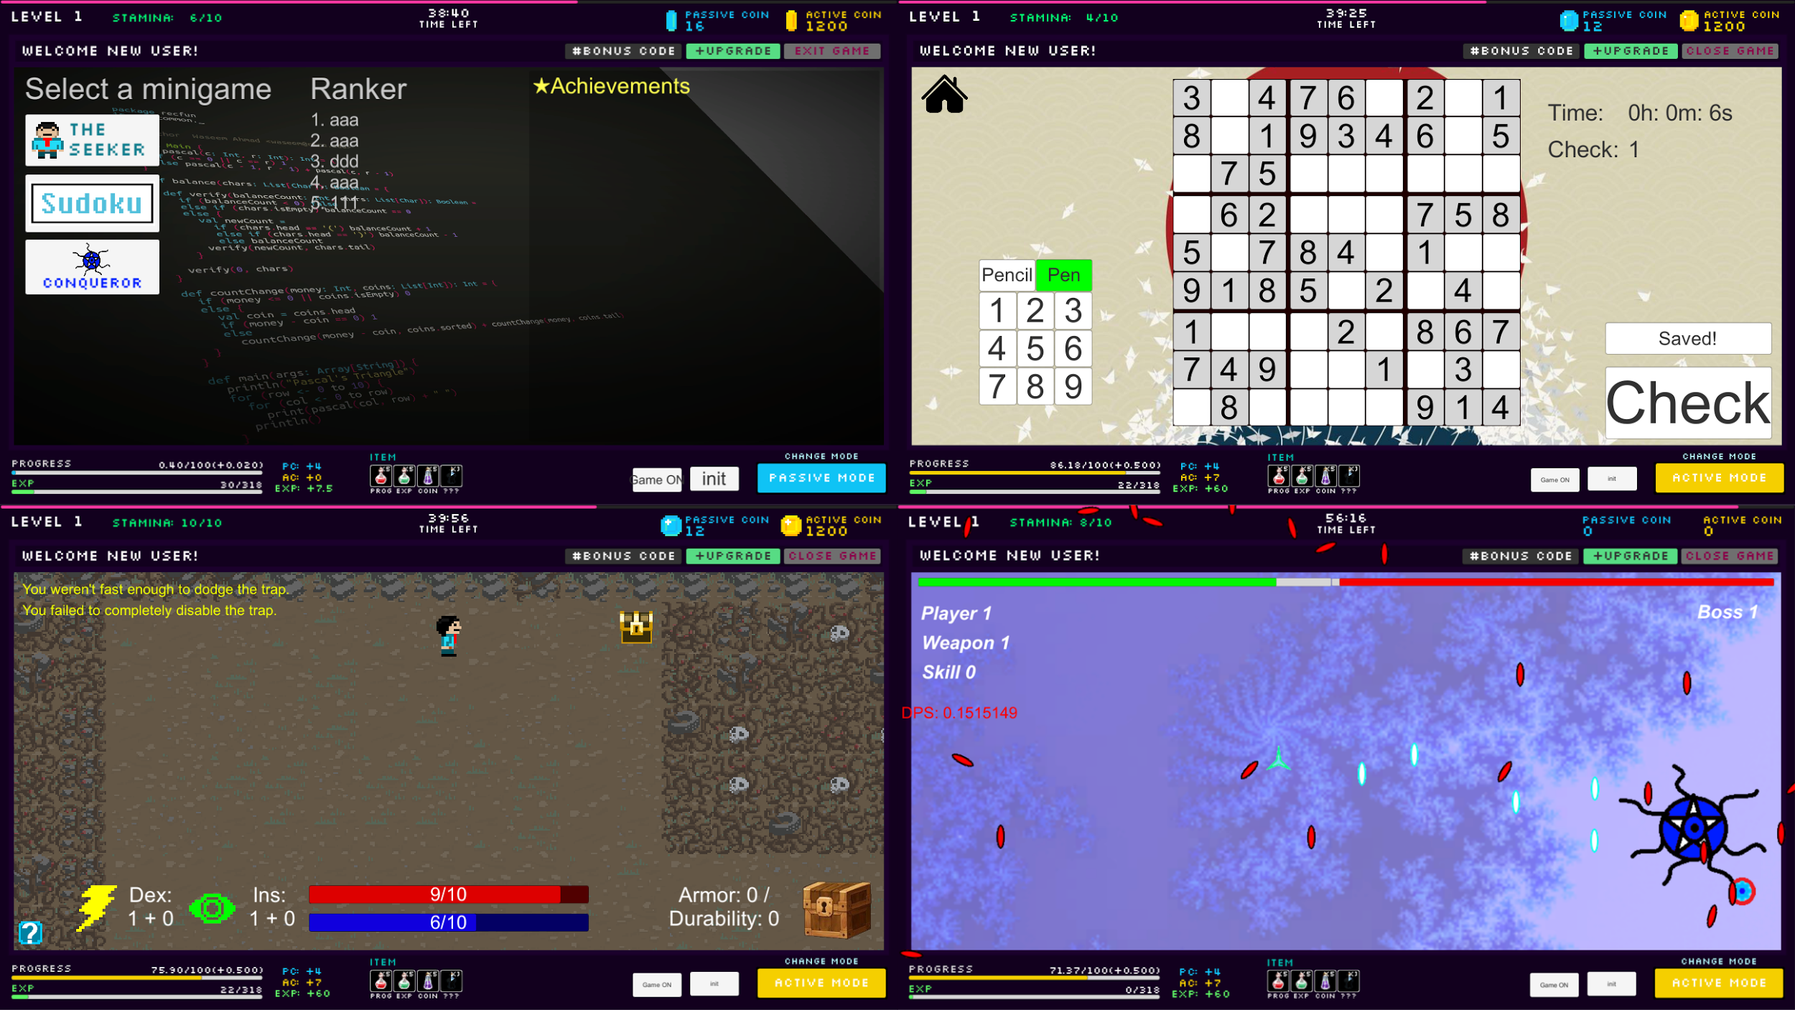
Gamification
Sponsor: WSU Intelligent Robot Learning Laboratory
Mentor: Chris Cain
Wai Fong, Wai Lok Cheng, Zachary Moore,
Sung Su Park, Casey Riehle
Overview & Motivation
Gameplay Screenshots
Game type: Seeker
Gamification is gaming elements in a non-game setting, such as the classroom. We designed a game for students to play that will track class-based effort and reward them accordingly. Our team’s goal was to design and create a game that is enjoyable to a majority of students such that they’ll be motivated to put more effort in their classes.
The seeker game is for those who are interested in story and exploration-based games. This game was designed as a third person story game along with dungeon exploration. The main gameplay is to go into dungeons to explore for treasures which can be sold for upgrades in either the seeker game or for incremental progress. There are traps hidden within the dungeon which hinders the player’s progress. The player will have to increase their stats to disarm the traps or to dodge them.
Goals
Motivate students in their academics
Reward students in game based on their effort in class
Require minimal work from the educator
Design a game and gather statistics from which we can test the hypothesis: A student playing a content-independent game outside of class with ties back to class will experience increases in self reported motivation and engagement in class and an increase in grades.
Game type: Mastermind
The mastermind game is for people who like to exercise their brain through different difficulty puzzles to gain accomplishment from solving them.
Our team chose Sudoku to represent mastermind. There are many puzzles split into 3 difficulty. As the player progress into harder puzzles, the time spending on thinking for the solution will also be increased. The benefit of solving harder puzzles is to challenge them and gain better incremental game rewards. The less mistakes the player makes, the more rewards they will obtain.
Incremental Game
Background
Incremental games have become a very widespread and popular genre over the past few years. They’re a genre of games which provide long lasting gameplay and rewards in increments. This provides gameplay for at least a semester and accessible for students with little or no game experience due to its simplicity. It’s supported by our three minigames to provide content for the student to do in order to level up and acquire rewards from the incremental.
Progress in each minigame provides progress in the incremental game through coins they earn. All three games are connected together with the incremental game. The student can earn coins from the minigames and use the coins to boost their level up. Leveling up unlocks new features in the minigames. By participating in class work, students have chances to get bonus codes which can be used in the game to gain bonuses such as coins or items.
Stamina is used as a restriction on game time to promote time management. If the student does not have enough stamina, they are unable to play the minigames. Students acquire stamina through work submissions and class attendance.
The rate of experience gained is dictated through active and passive modes. In active mode, faster progress is enabled for a set amount of time. Active time is earned through the same means as stamina. Passive mode provides player experience passively even when the game is not running.
While there have been many games created for the sake of learning, nearly all of them are learning games rather than motivators. The fundamental aspect of this game is to provide students with a reward for when they show effort in their classes. This is measured by their class attendance, homework submissions, and lab submissions.
Game type: Conqueror
The conqueror game is for people who enjoy a challenge and seek enjoyment from difficulty. It is a top down shooter that pits the player against strong enemies. As your opponents get stronger, so do the rewards for victory. New weapons can be acquired and skills can be unlocked. These bonuses are essential for overcoming the enemies found later in the game. All bosses have unique mechanics that may require multiple attempts to defeat. This can provide a feeling of satisfaction and accomplishment that conqueror style players may enjoy.
Solution
To provide gameplay for a variety of students, we developed three minigames for different player preferences and an overarching game to tie them together. Unity3D was used as the development platform and Tiled as a tool for game map creations.
The Incremental game contains different mini-games, and each mini-game will represent its own genre element. Therefore each mini-game gathers specific genre statistics to help on the research to see how students tend to spend their time.
The game saves and loads data using the EECS server via websockets where the data is stored using the MongoDB database program. Assignment submissions, attendance, etc. are read from CSV files, supplied from the TA/instructor, and apply the appropriate rewards for the incremental in the database.
Acknowledgments
We would like to thank the following people for their help and support:
Chris Cain, Alex Joens, WSU Intelligent Robot Learning Laboratory, and Behrooz Shirazi
Team Gamification

